Slide 1
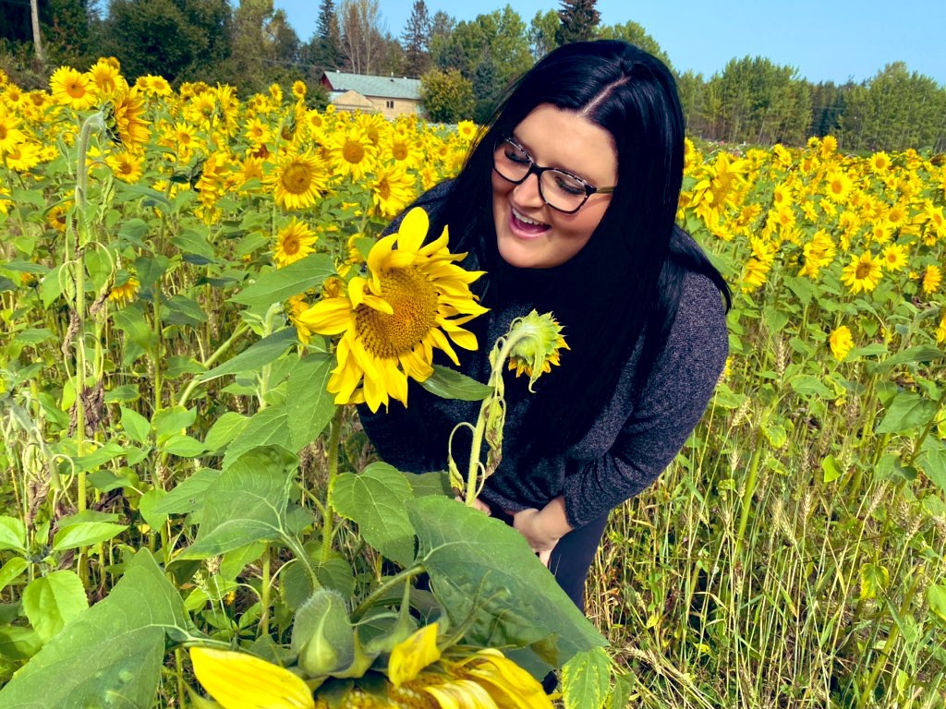
Kelsey MacDonald
2301414536
IMAGINE STUDENT GROWTH...AND SUCCESS
Our Land, Our Place, Our People

Slide 2
Personal Manifesto
Student growth and success needs nuture, love, and care
Nurturing, loving, and caring for a child requires important concepts and beliefs that teachers bring to the profession
This book represents those concepts and beliefs that I personally relate to, and bring, in my teaching philosophy

Slide 3
Language and Literacy
"Playing with language helps us discover how language works" - BC Curriculum
Figurative language, pictures, and symbols help to grow our literary elements of a story into meaningful text
This text is used to share our stories
The pictures in this book represent my story as a teacher candidate
By sharing my story, I am able to invite my students to share their stories

Slide 4
On our land, in our place, and with our people...
Let's Imagine a Time when we are..

Slide 5
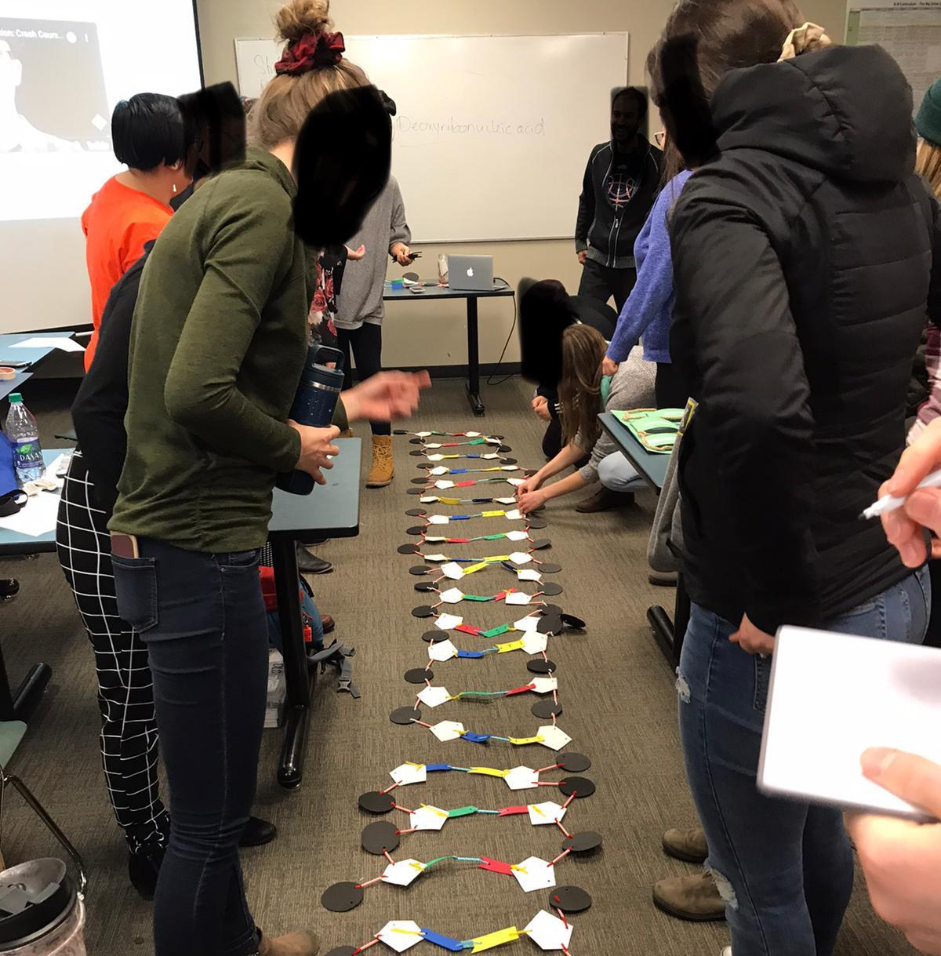
Working Towards a Common Goal

Slide 6
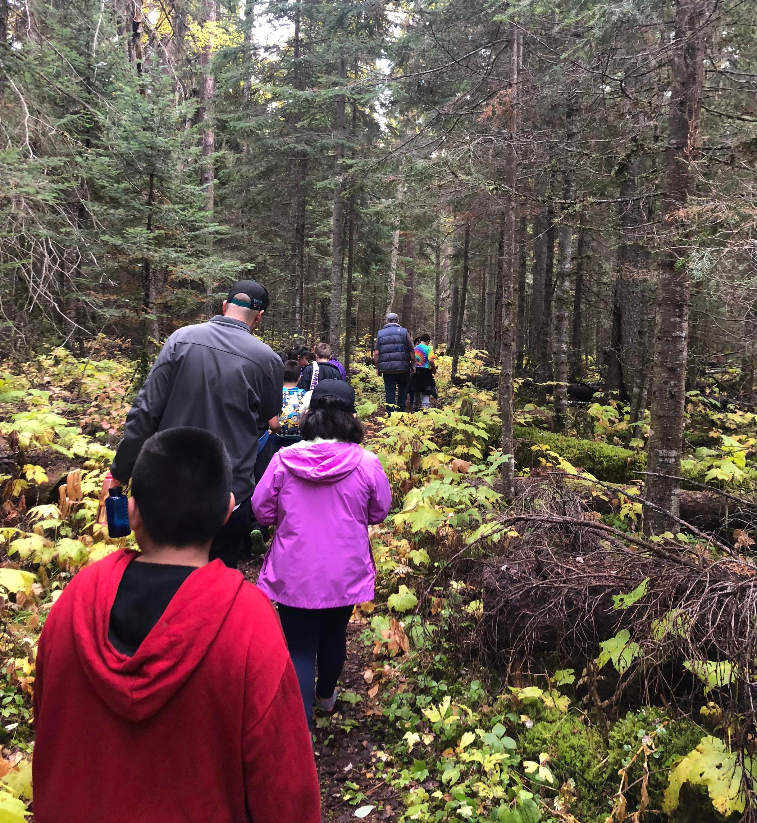
Working With Each Other

Slide 7
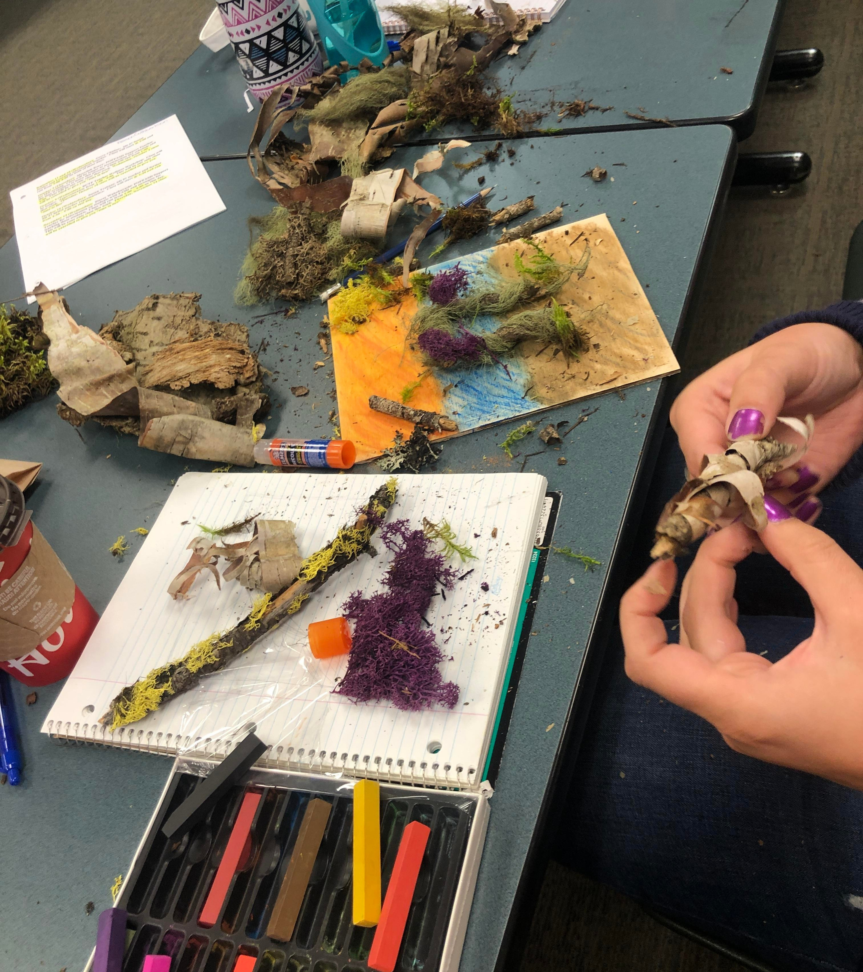
Giving a Helping Hand

Slide 8
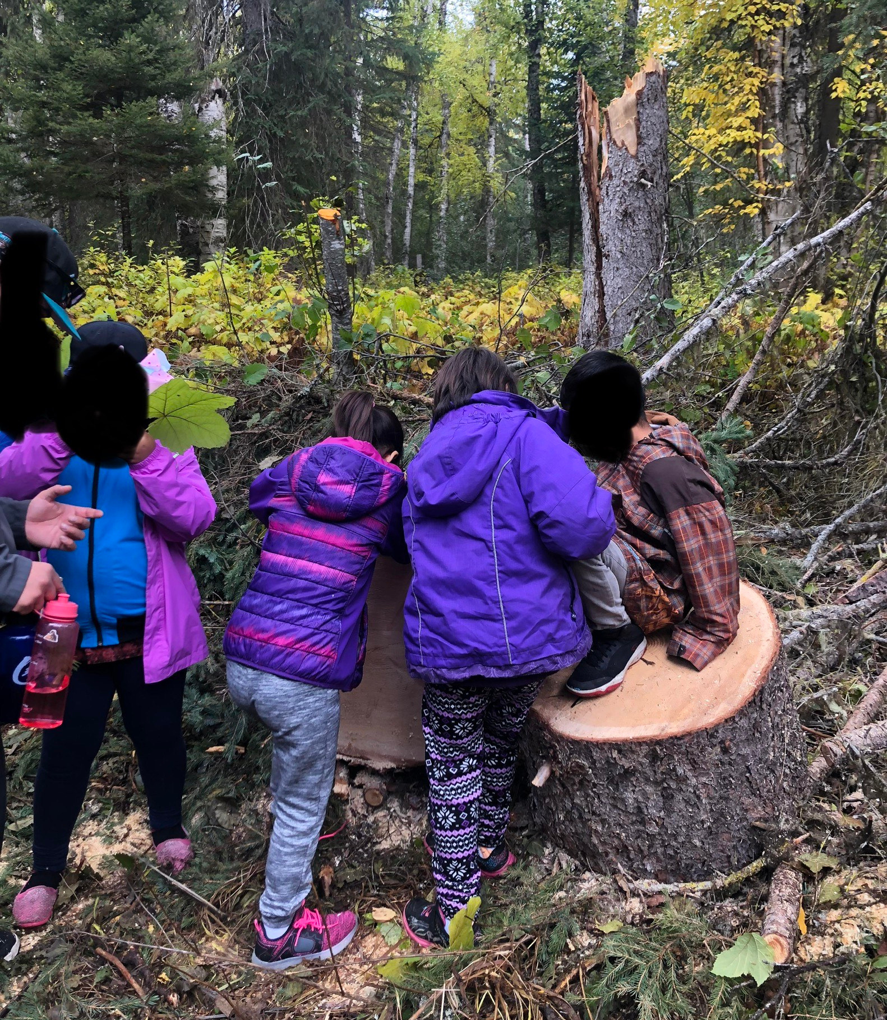
being Curious

Slide 9
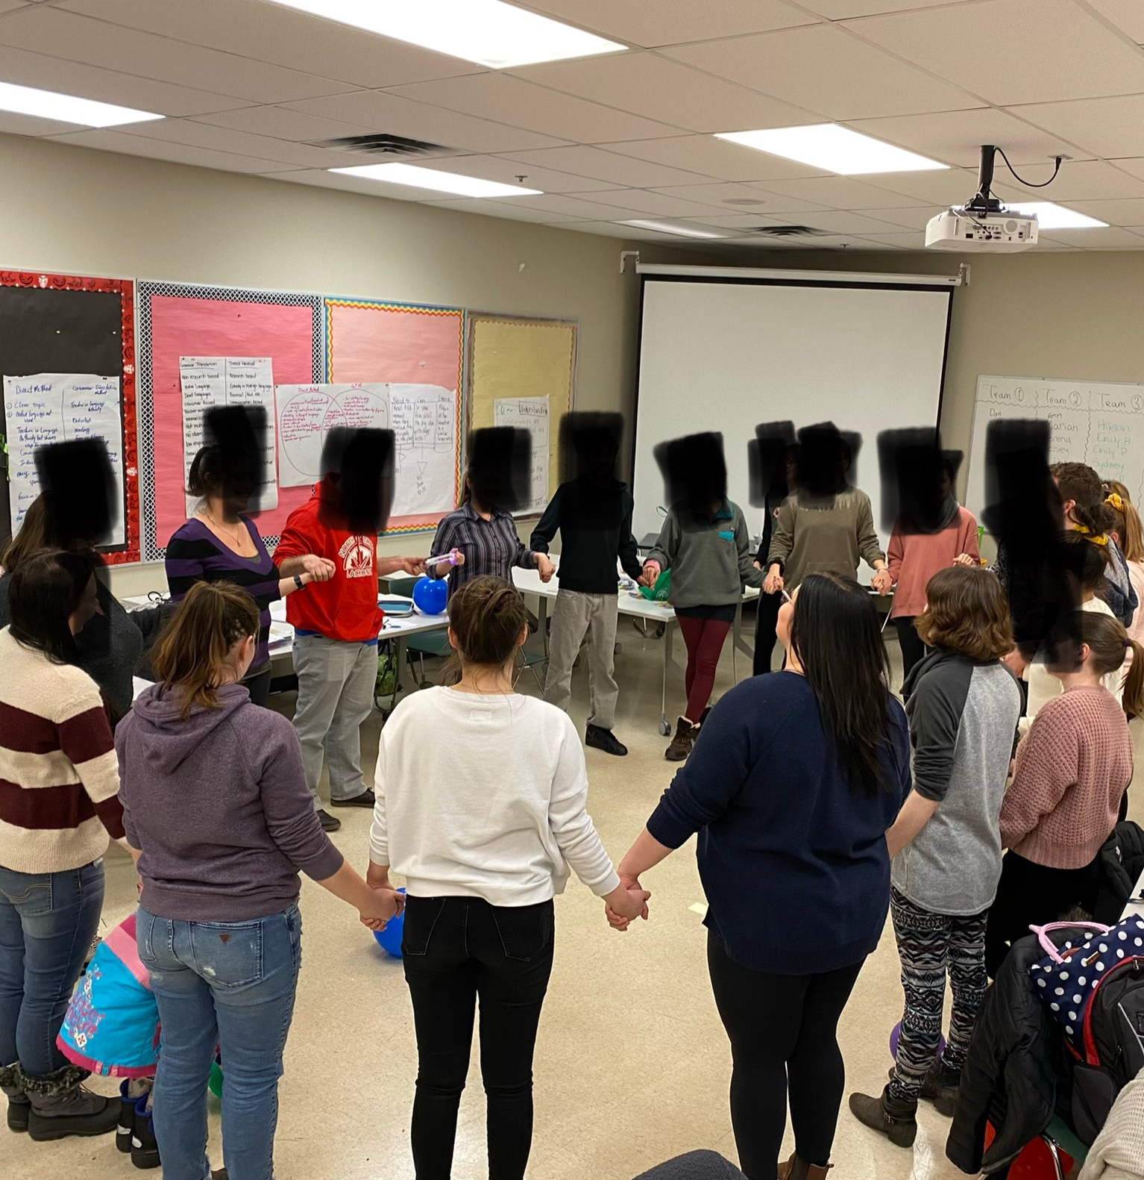
being Collaborative

Slide 10
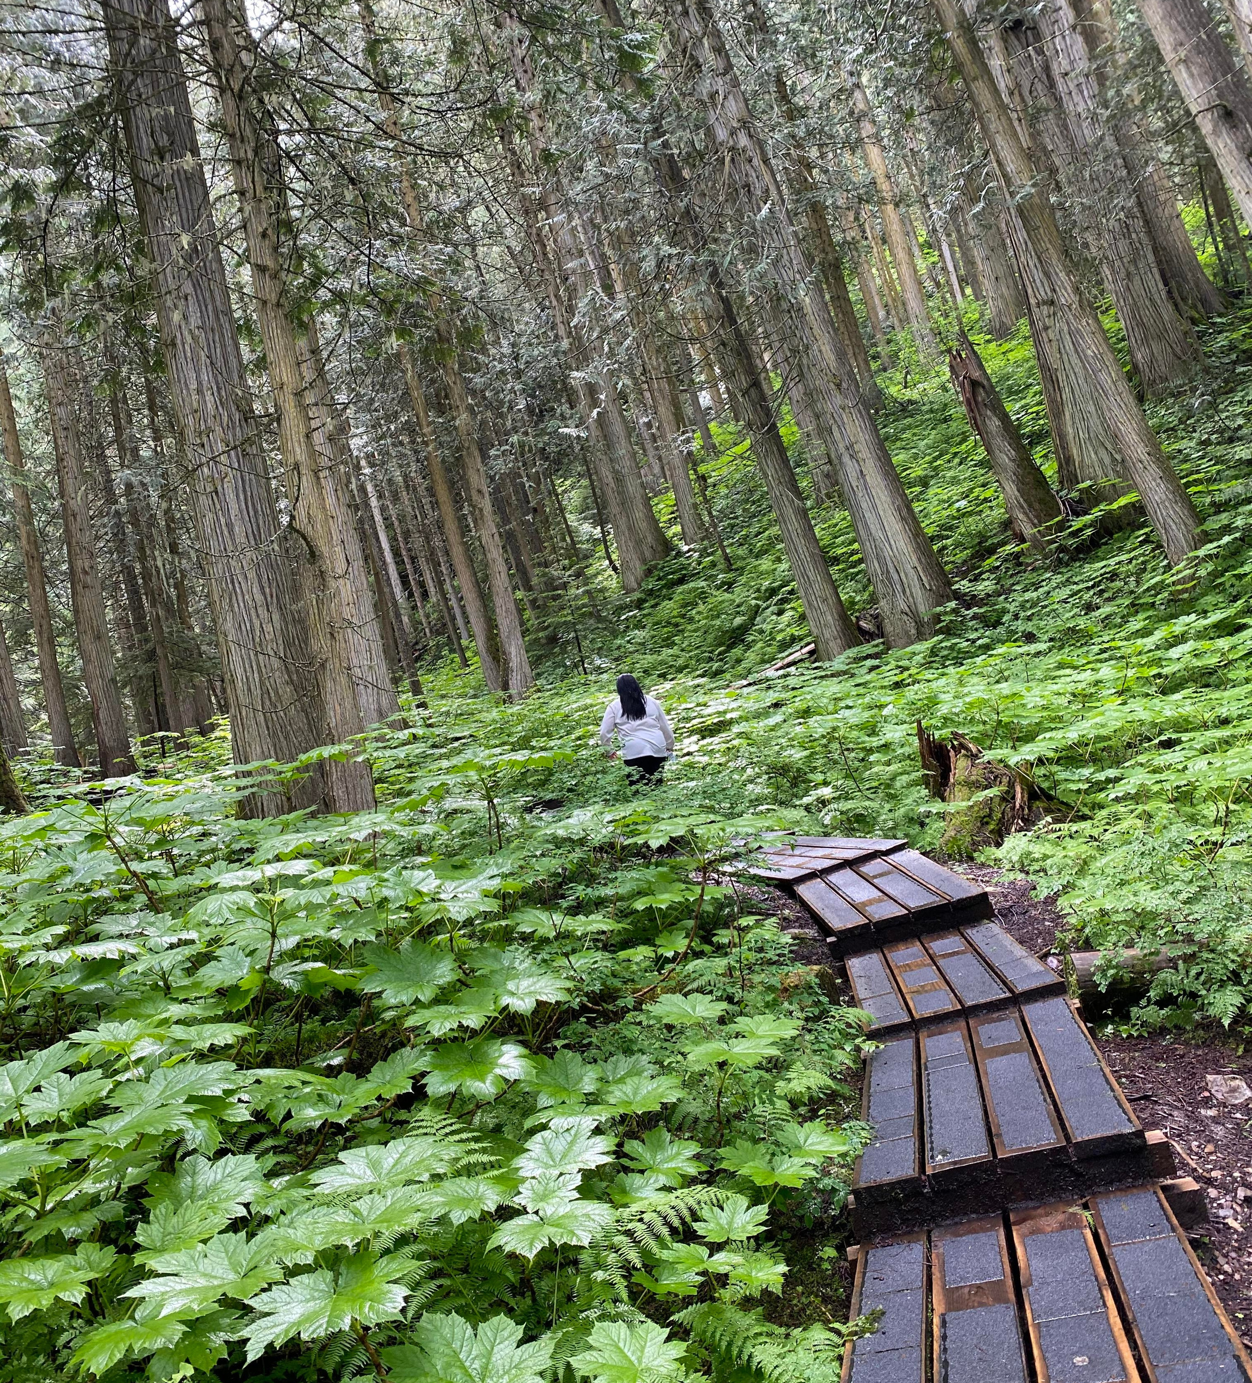
exploring

Slide 11
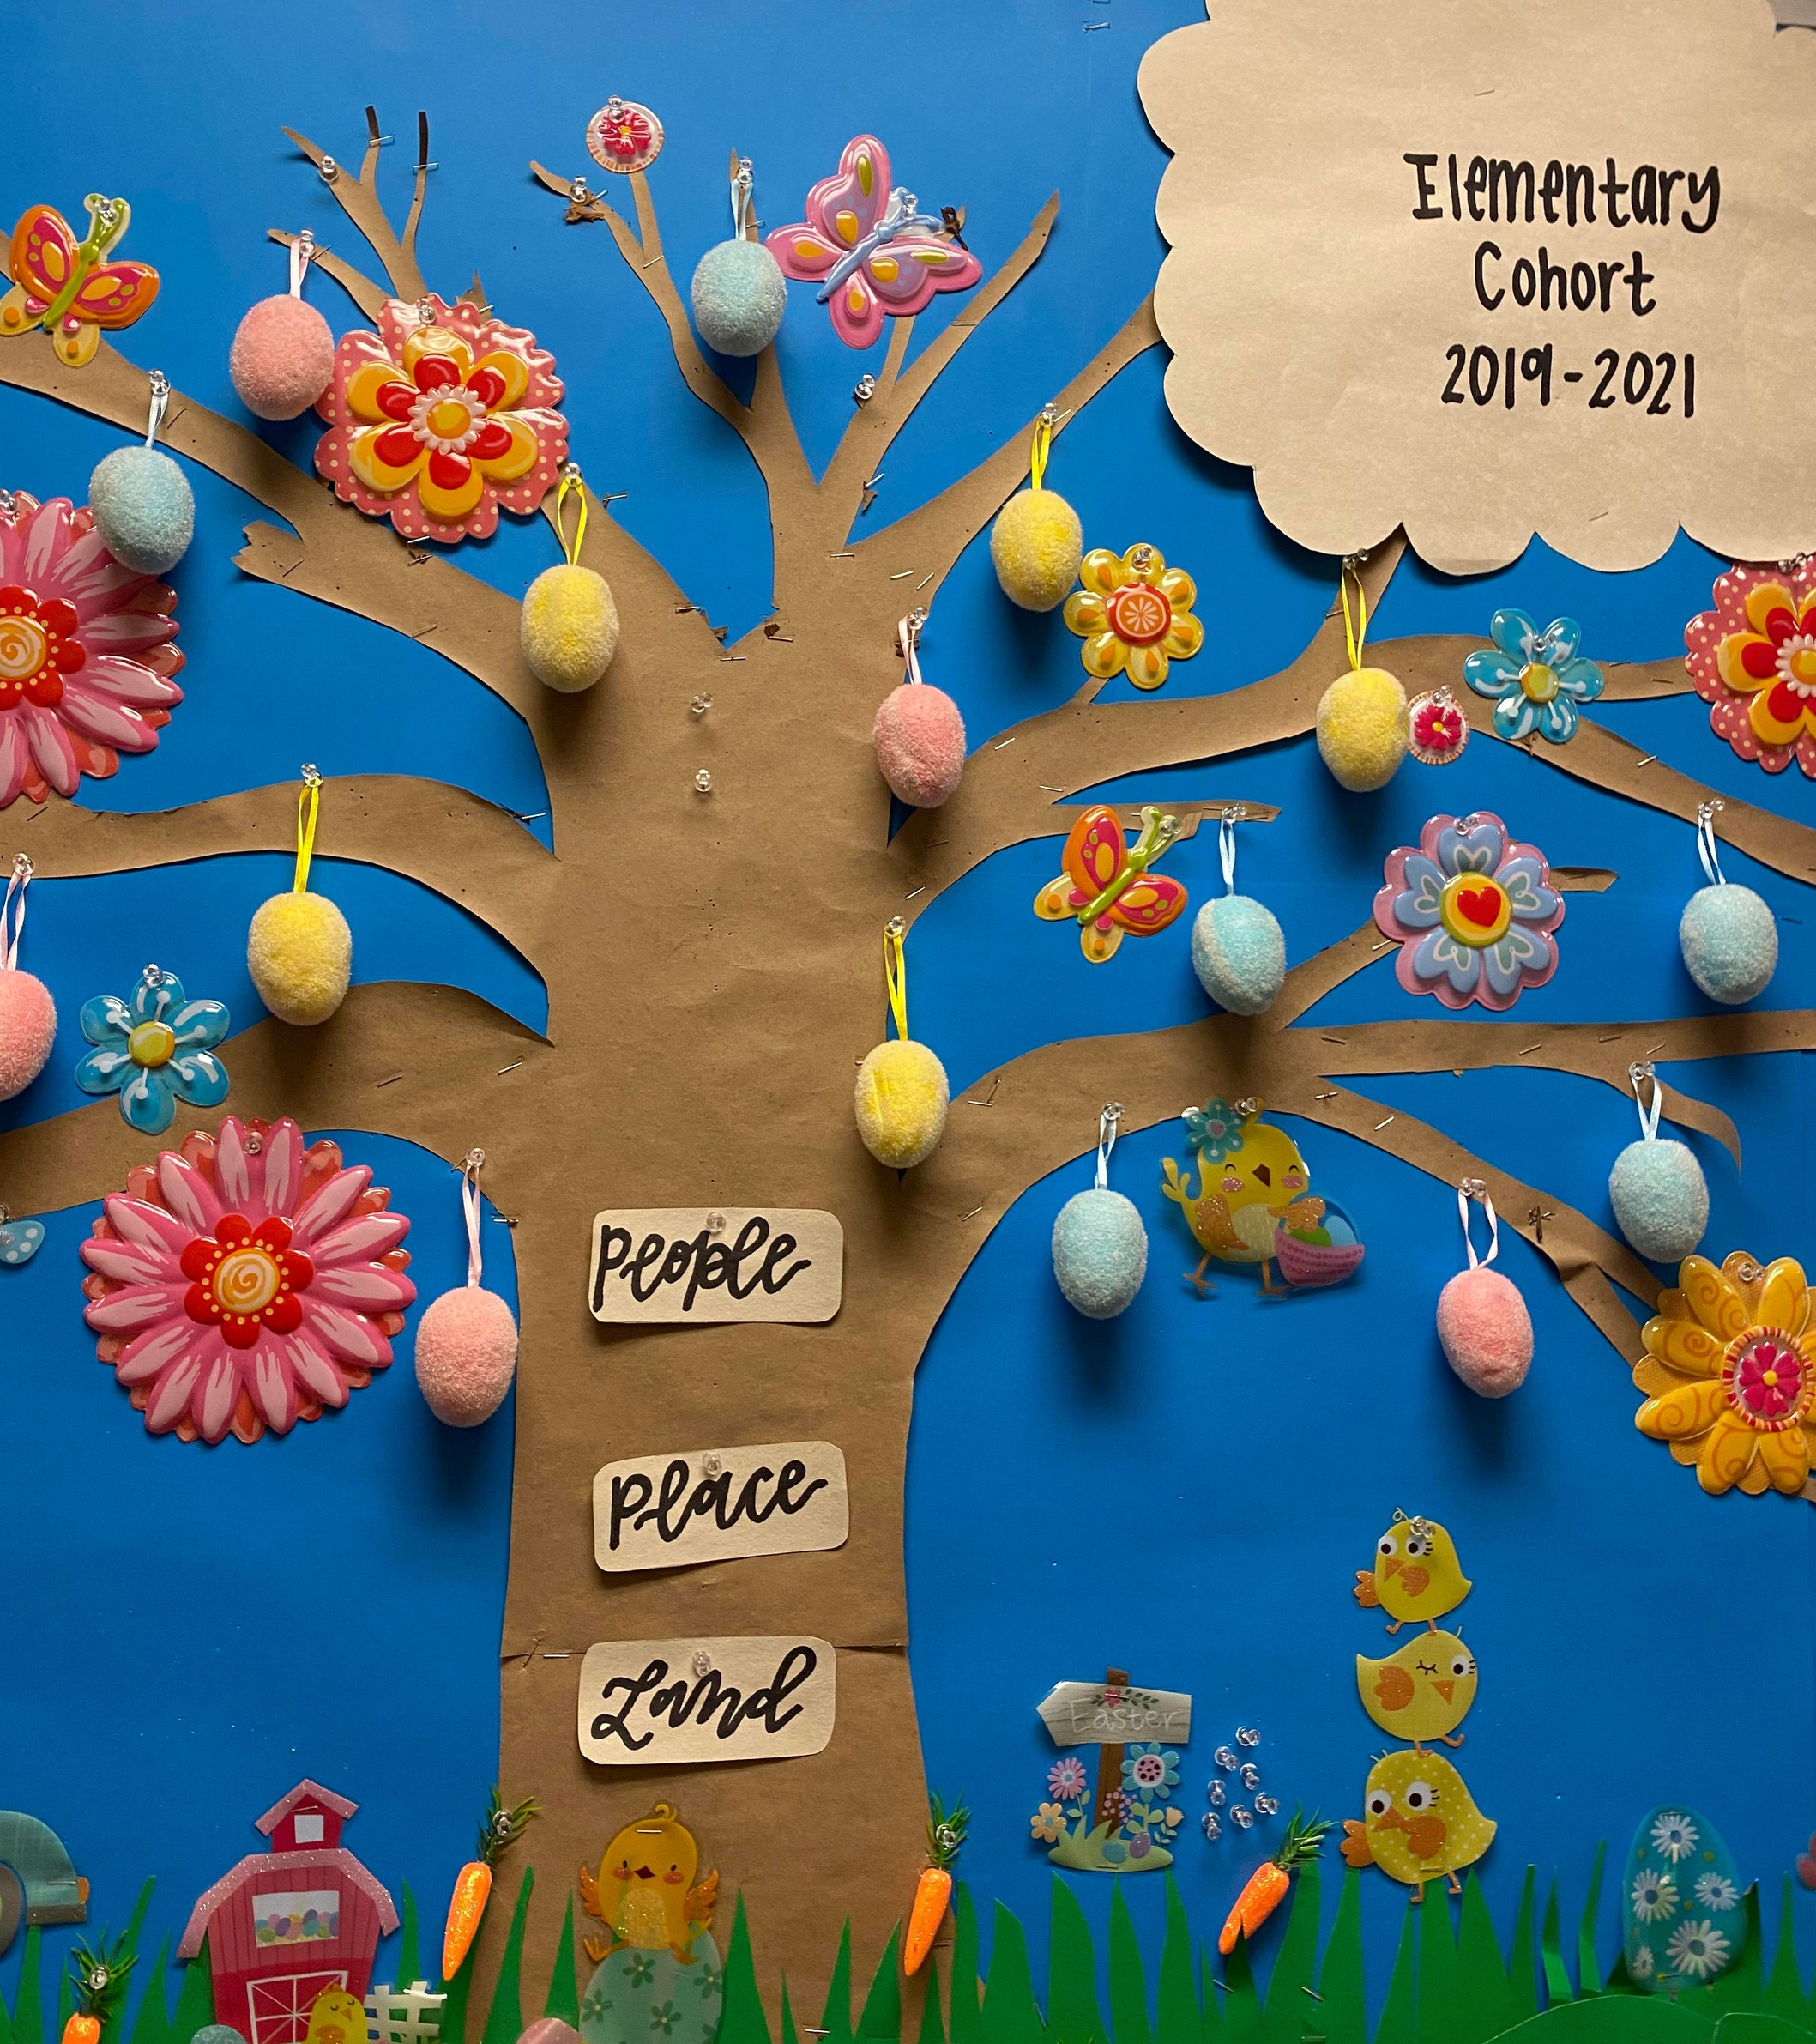
being Creative

Slide 12
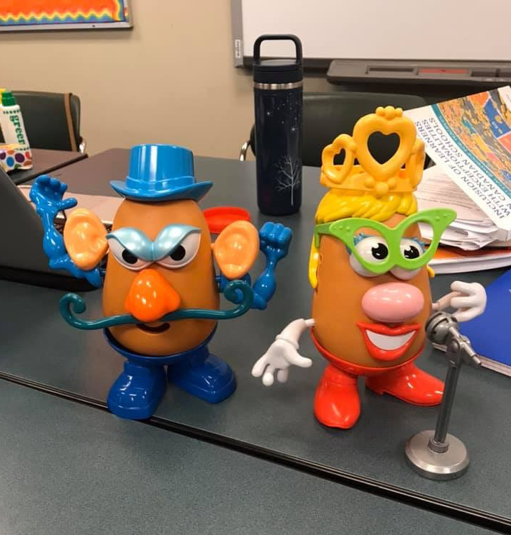
being Innovative

Slide 13
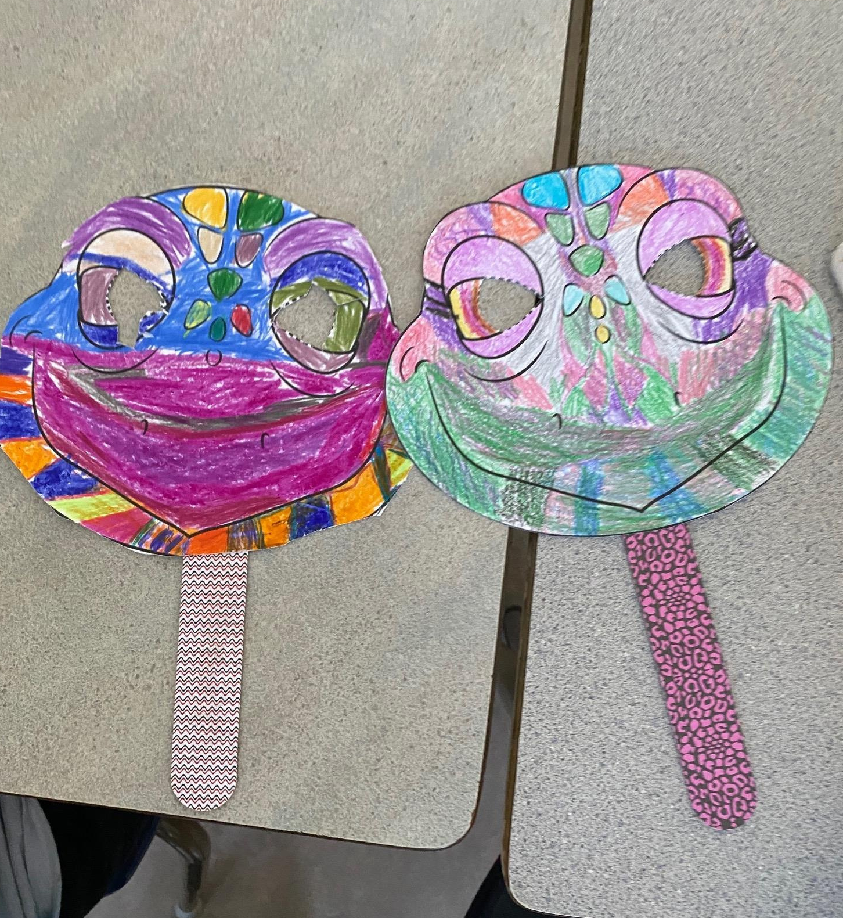
Embracing Diversity

Slide 14
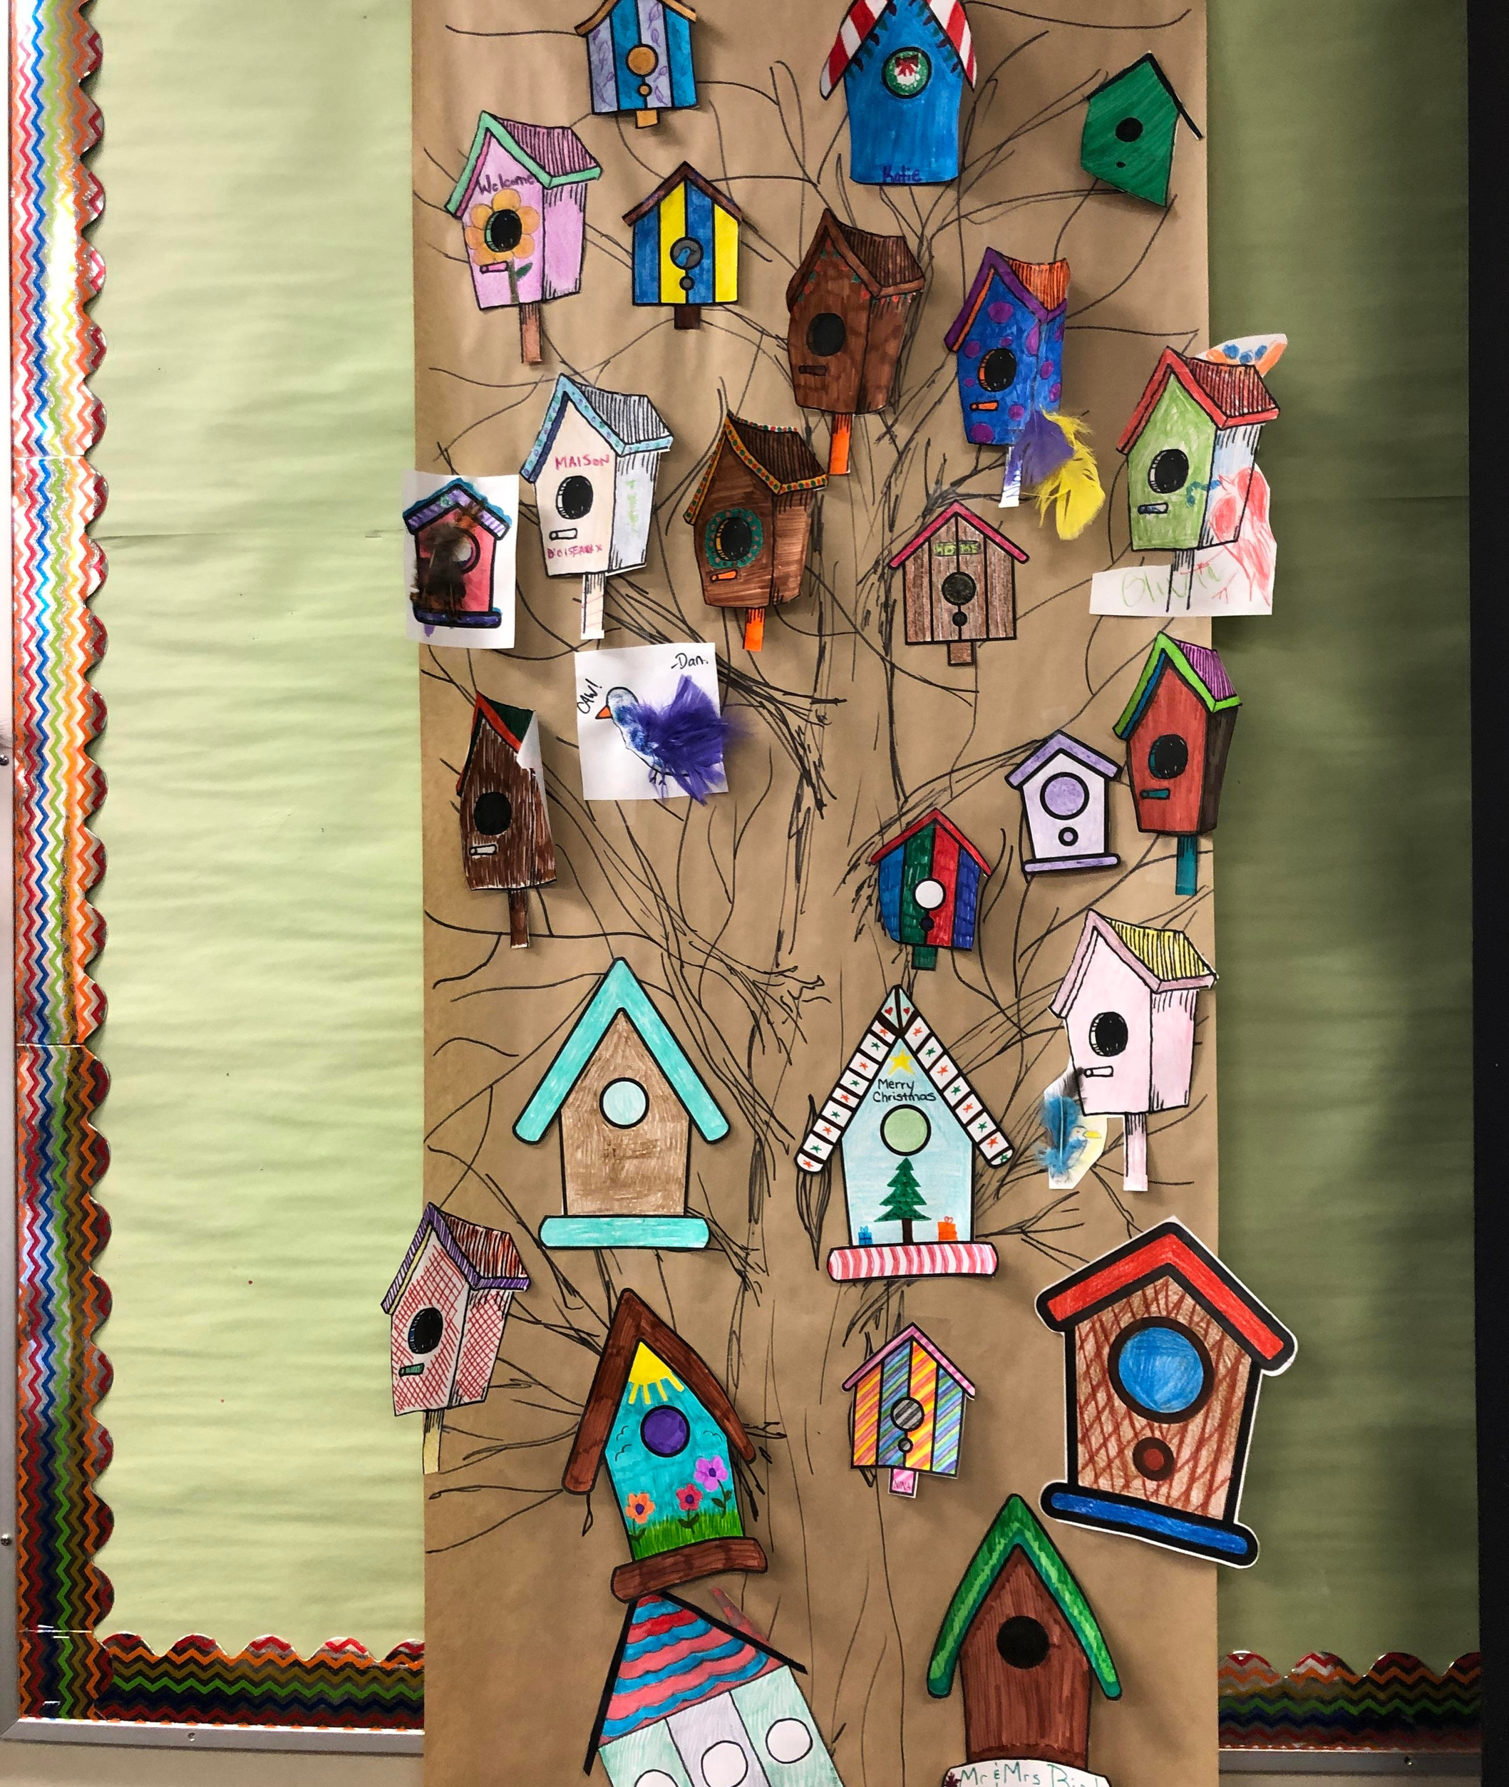
Allowing Choice

Slide 15
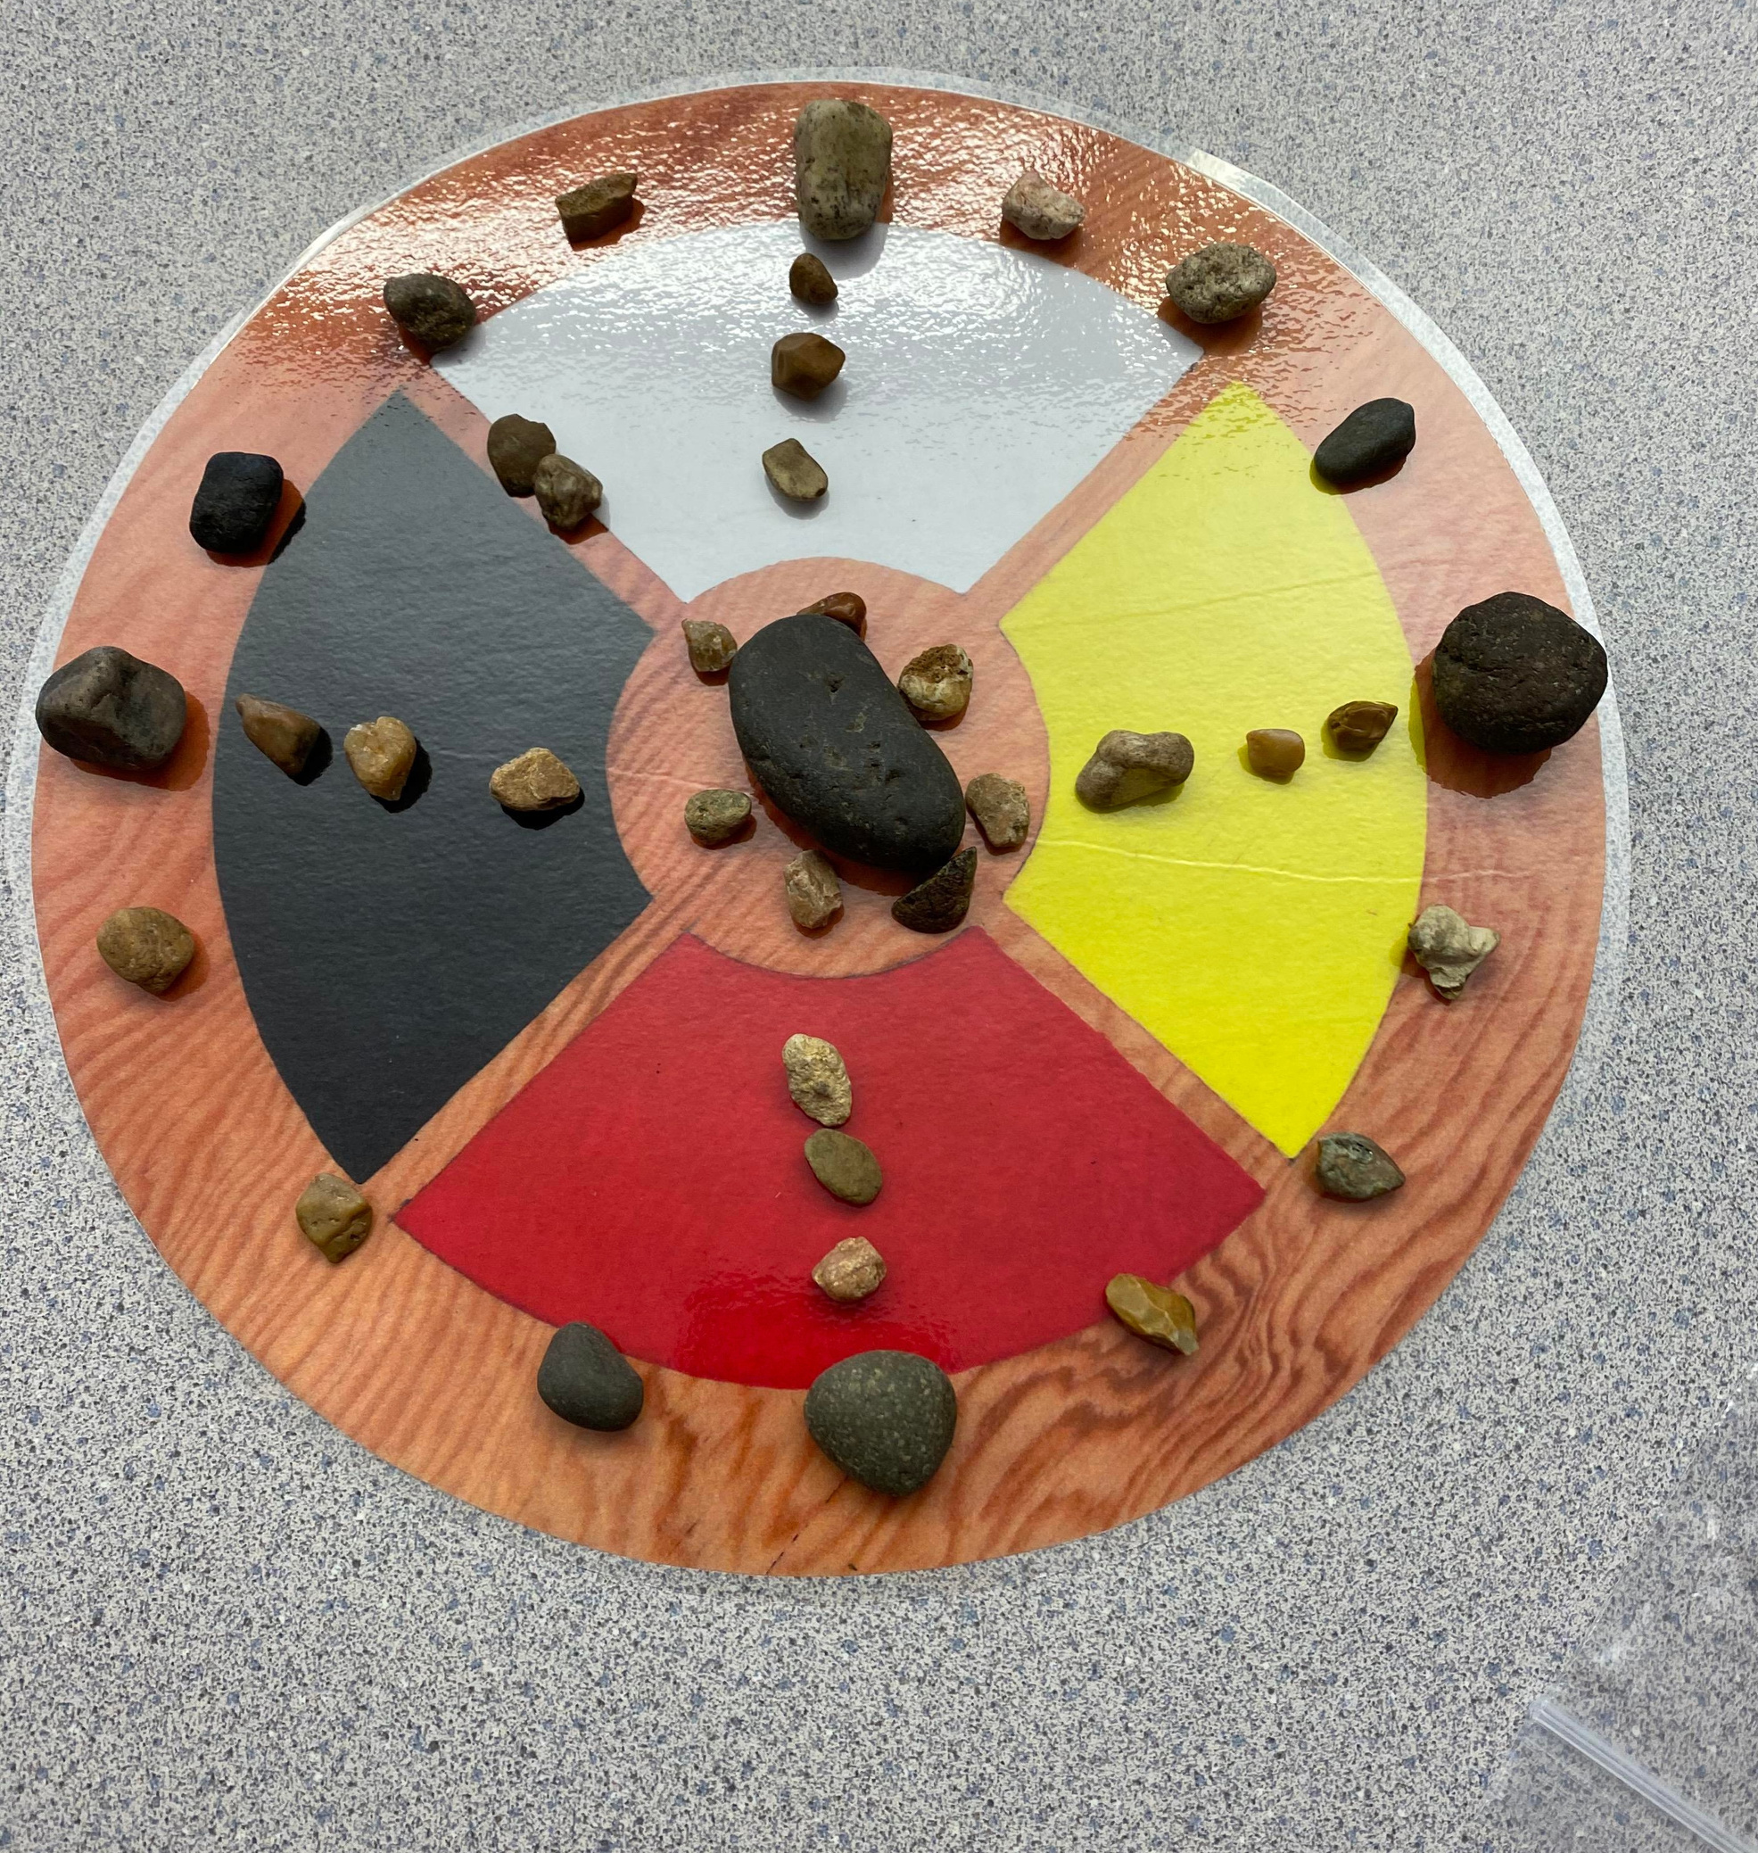
Providing Balance and Harmony

Slide 16
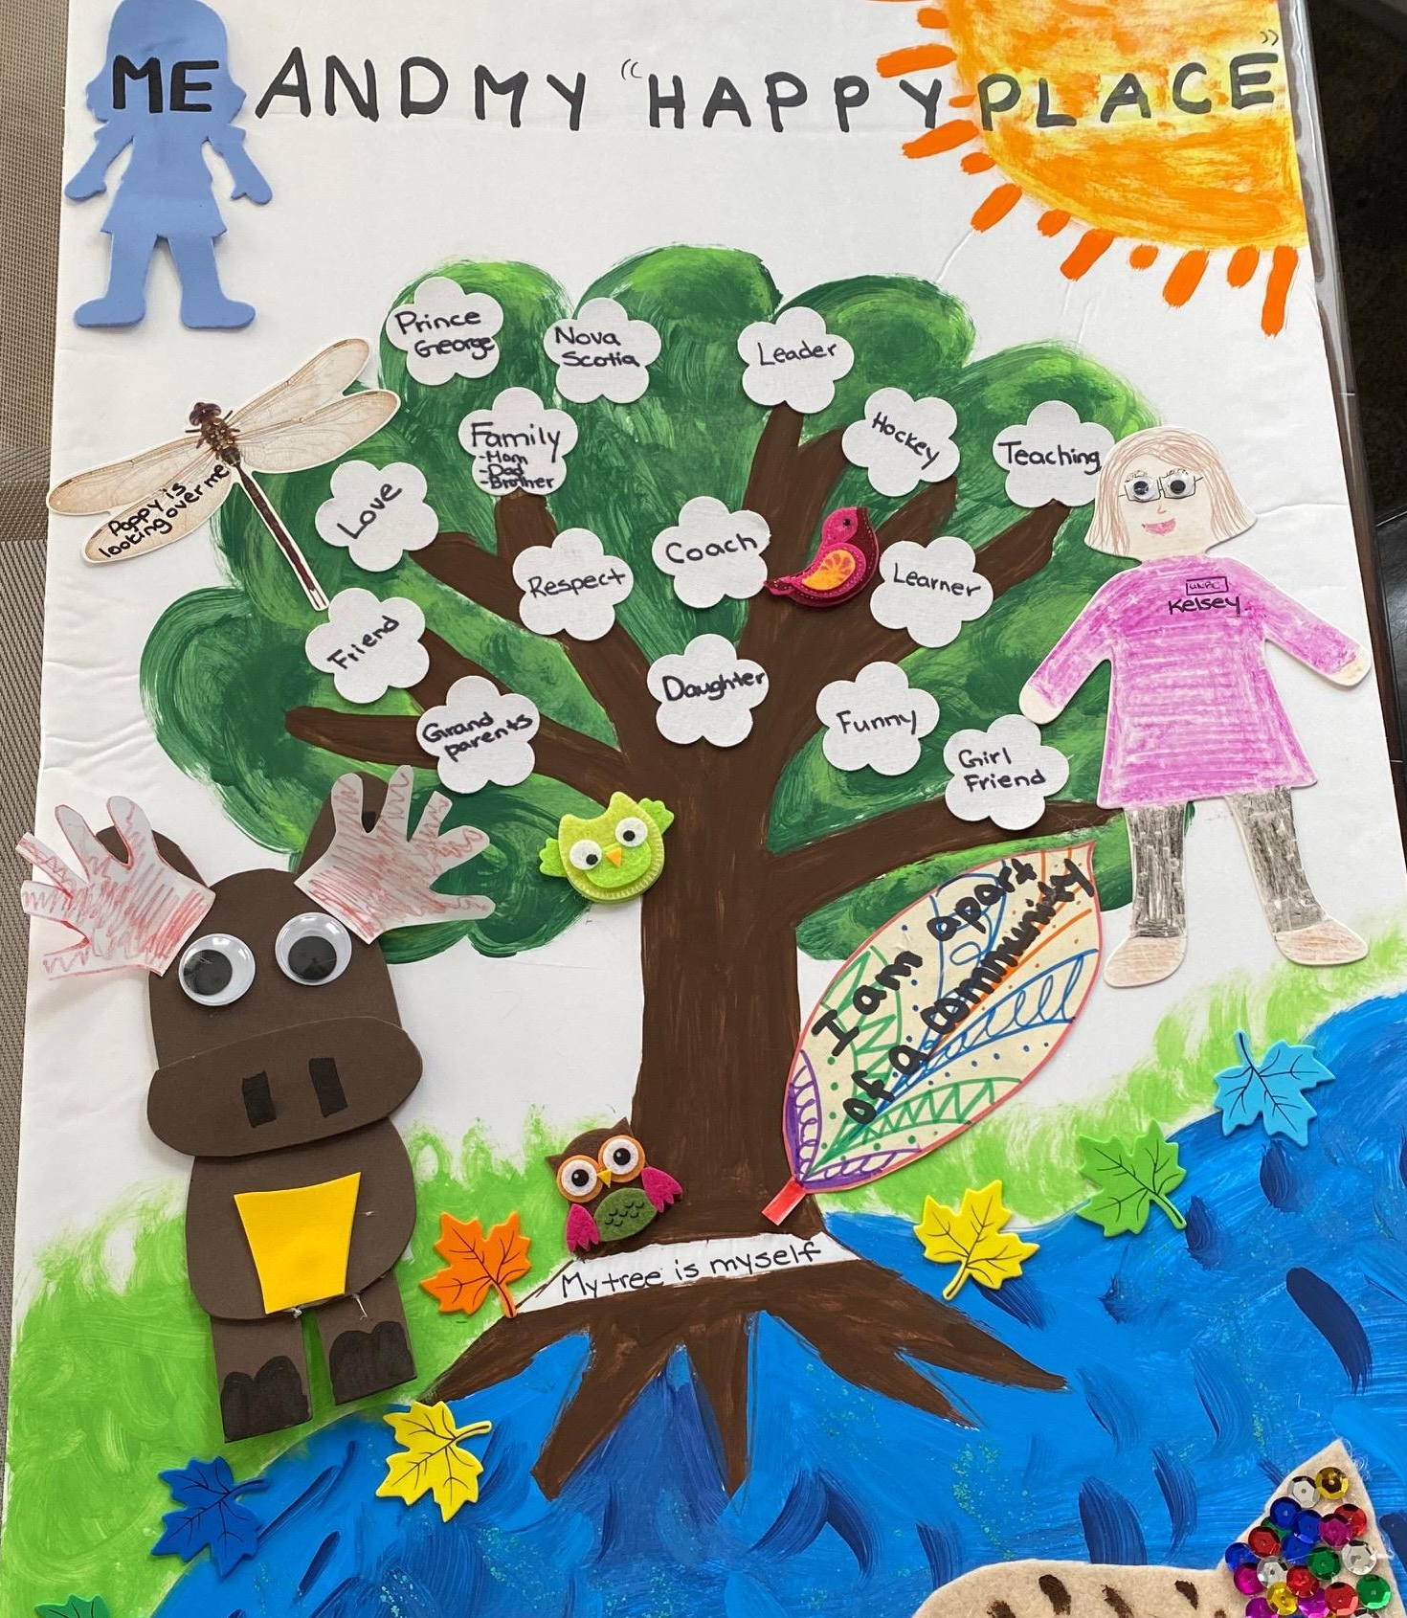
in our Happy Place

Slide 17
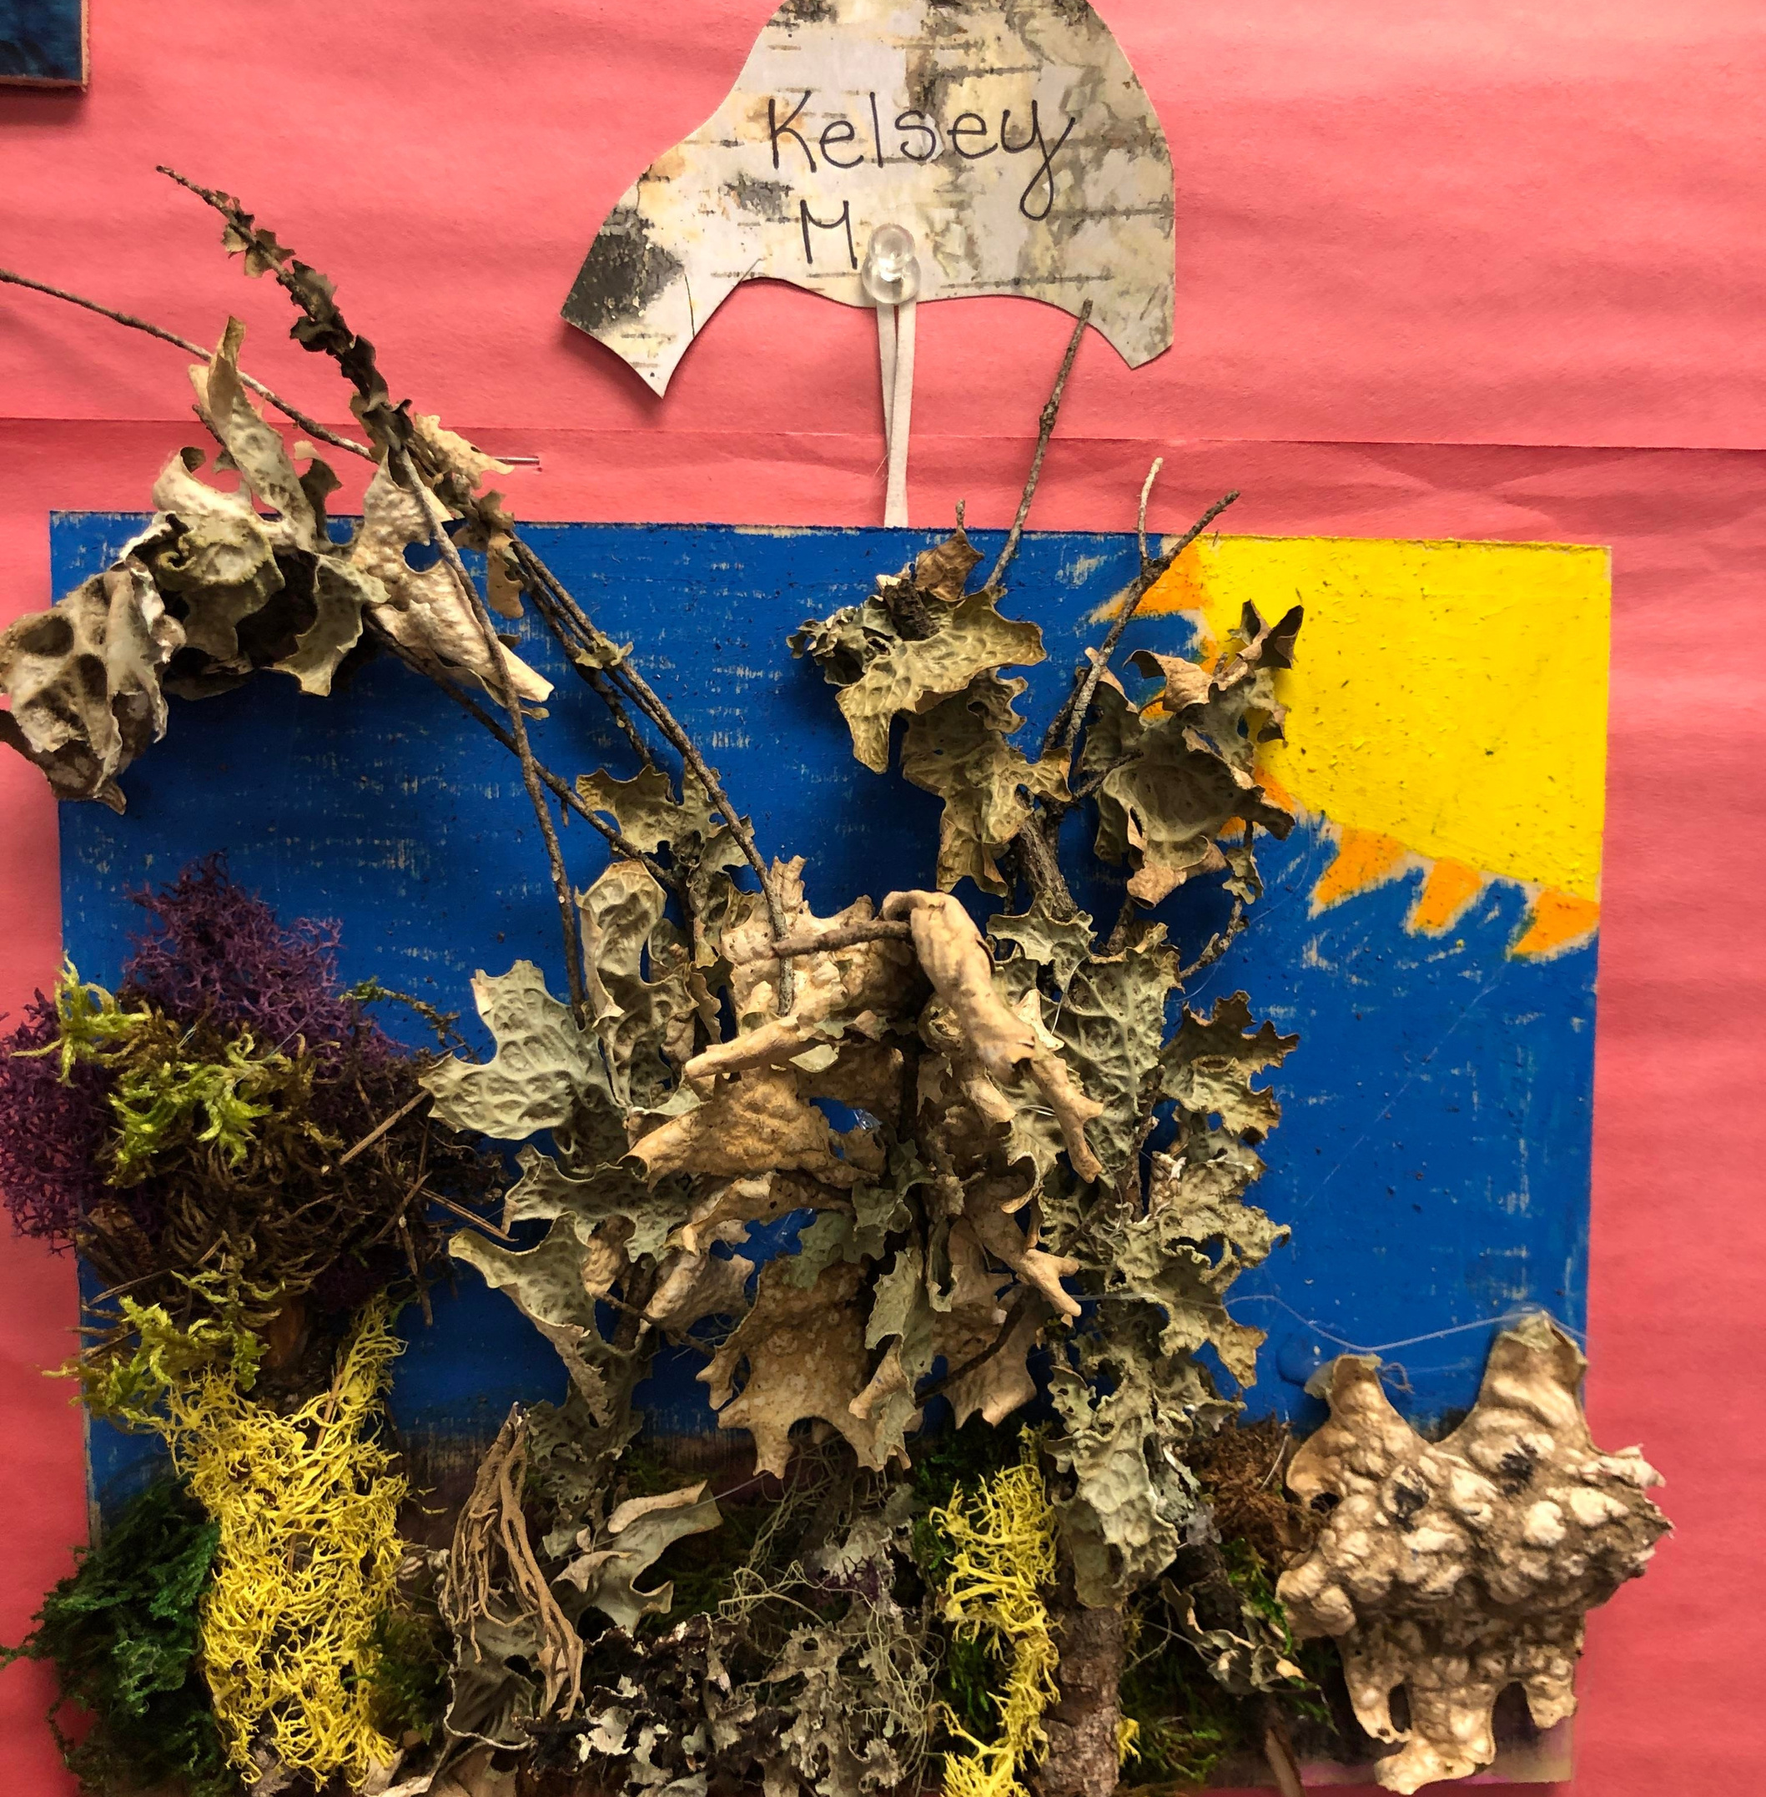
Celebrating a Job Well Done

Slide 18
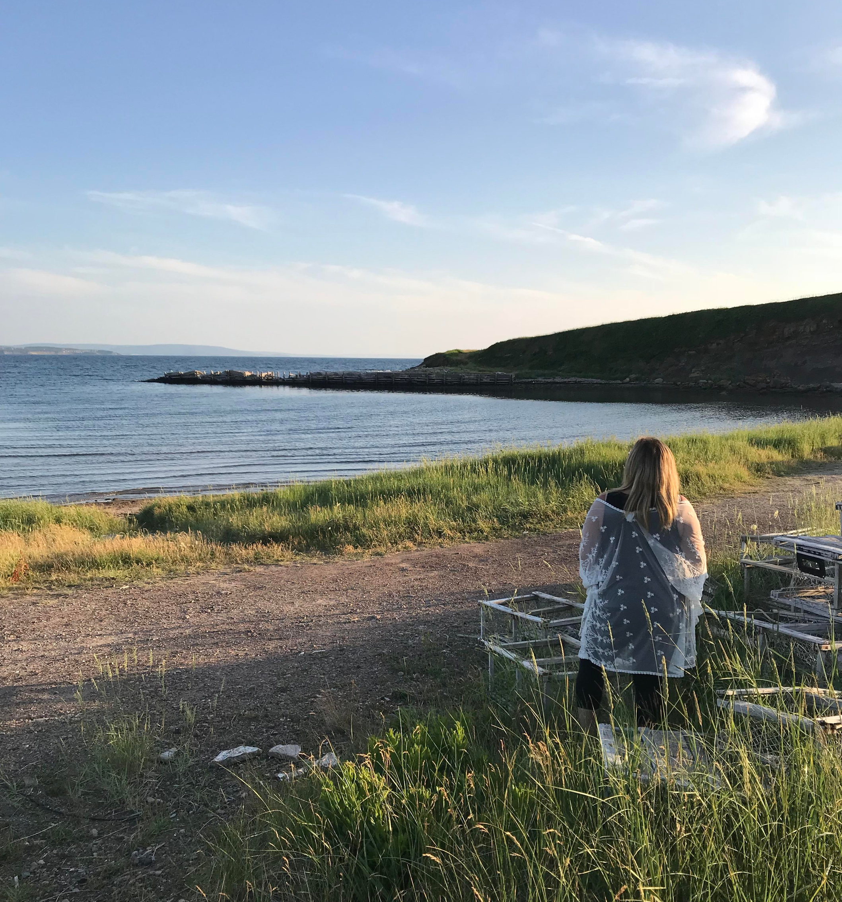
Looking Ahead

Slide 19
Celebrating
Growth...and Success

Slide 20
Celebration
"Celebrations are an opportunity to take intentional notice of what the learner is atempting to do and to comment on it in explicit language that validates the learner's efforts" (Routman, p. 27)
"Perhaps what I love best about celebration is its power to change and elevate a student's life, in and out of school" (Routman, p. 26)

Slide 21
References
British Columbia Ministry of Education. (2016). BCs New Curriculum. Retrieved from
https://curriculum.gov.bc.ca/curriculum/overview
Canadian Children’s Literacy Foundation. (2020). Literacy Matters. Retrieved from
https://childrensliteracy.ca/
Harvey, S., & Goodis, A. (2019). Reading Picture Books. Retrieved from
https://www.literacytoday.ca/old-sections/reading/reading-strategies/reading-visual-texts/article/reading-picture-books
Mintz, A. I. (2018). The present, past, and future of
the gardening metaphor in education. Oxford Review of Education, 44(4), p.414-424.
Routman, R. (2018). Literacy essentials: Engagement, excellence, and equity for all learners.Portland, ME: Stenhouse.

